Slide 1
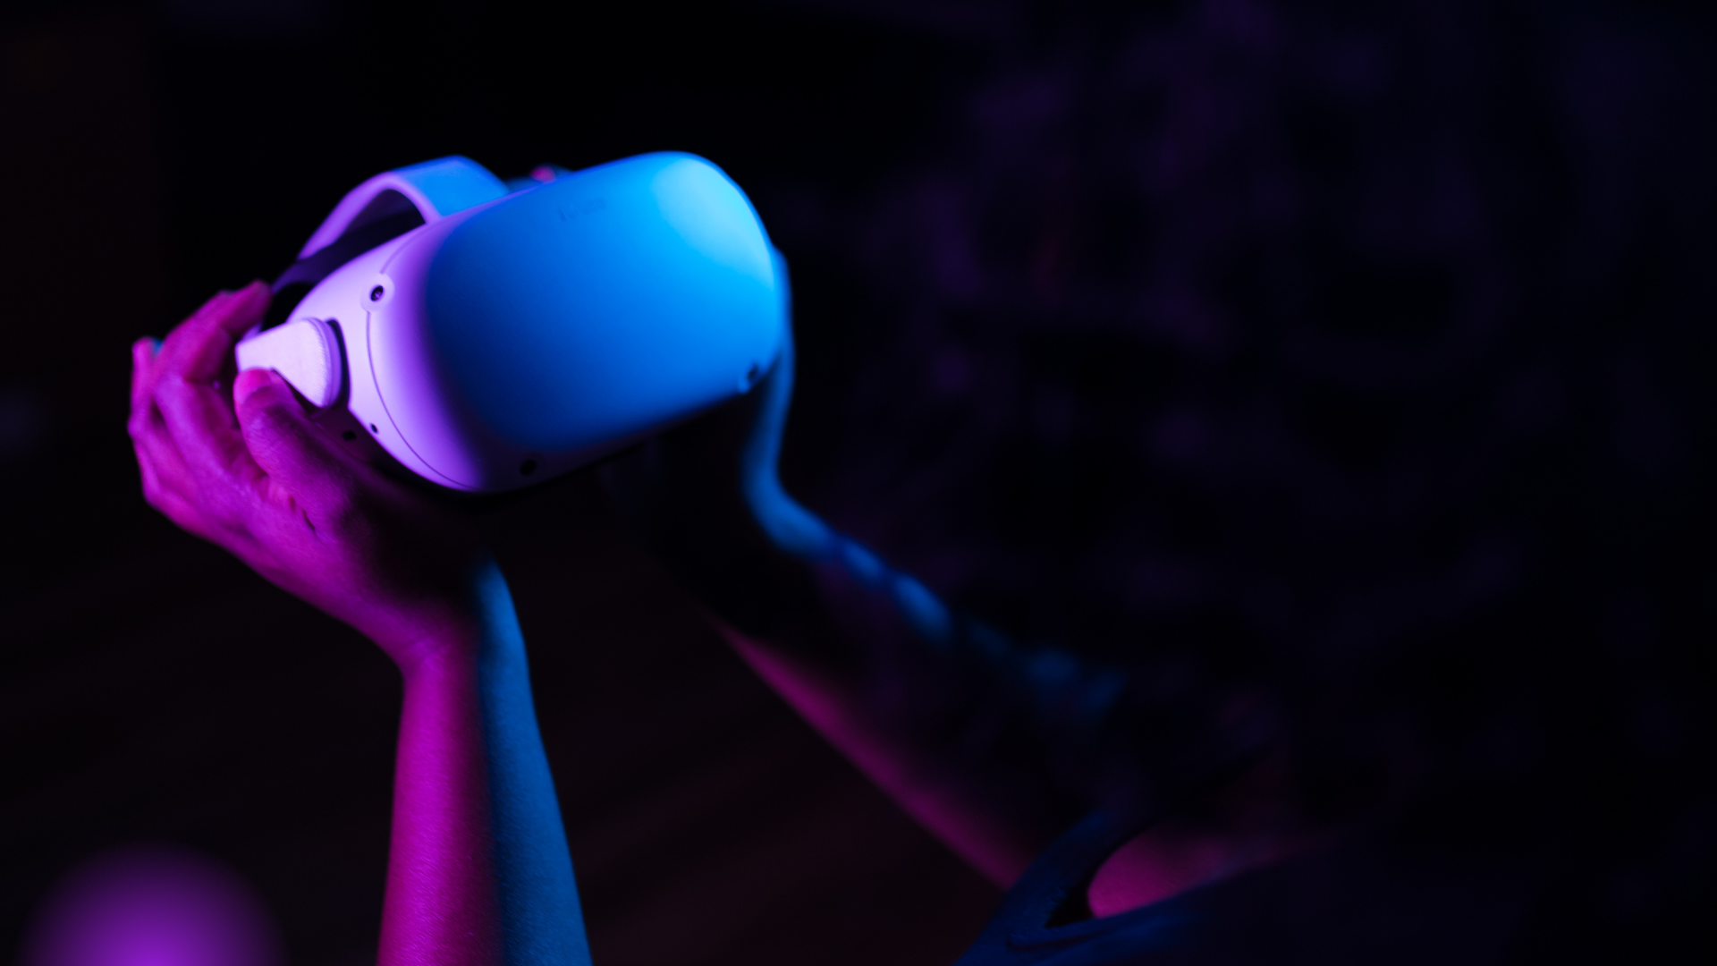

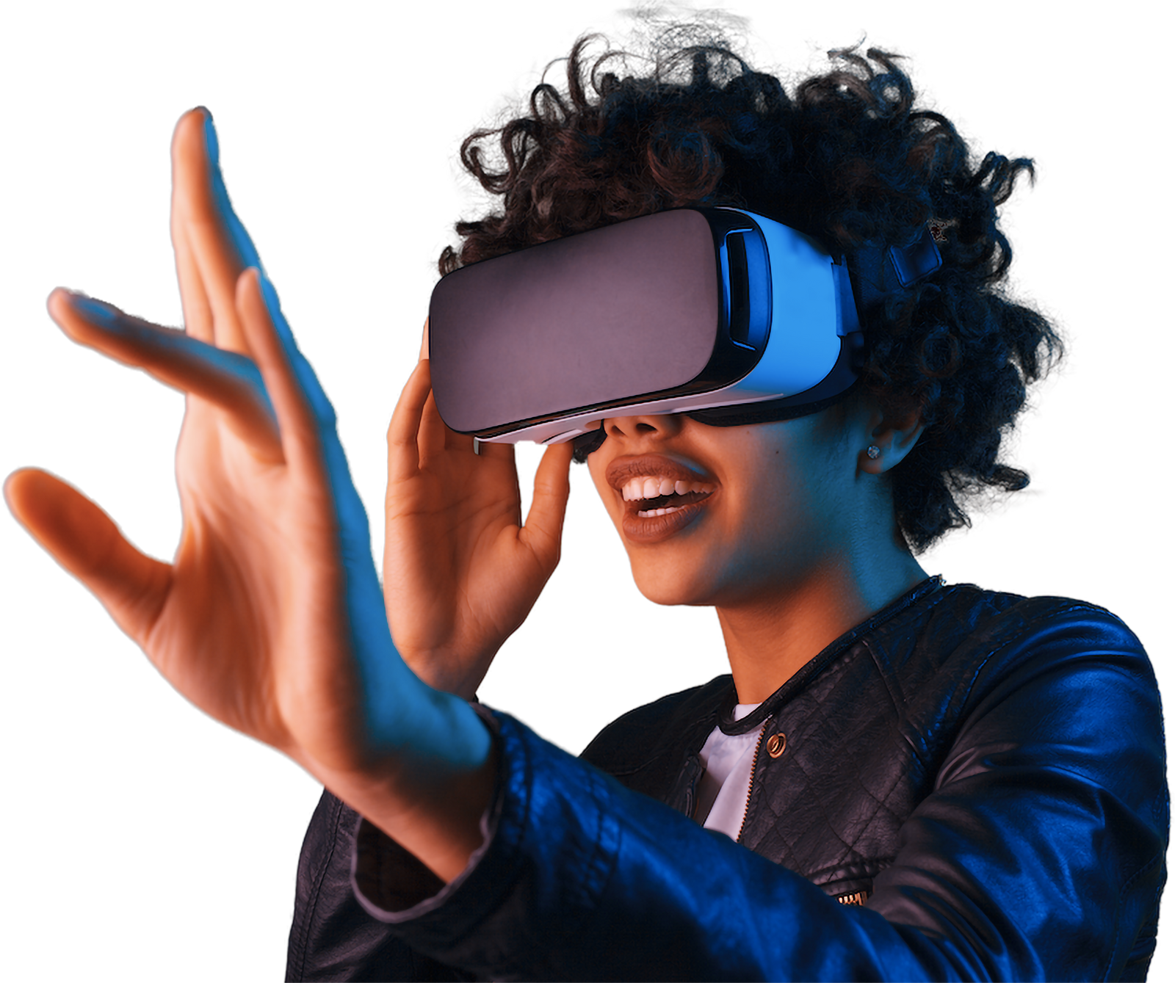

Revolutionizing Advertising with Augmented Reality & CGI
Engage Audiences
Amplify
Brands
Drive
Results

Slide 2
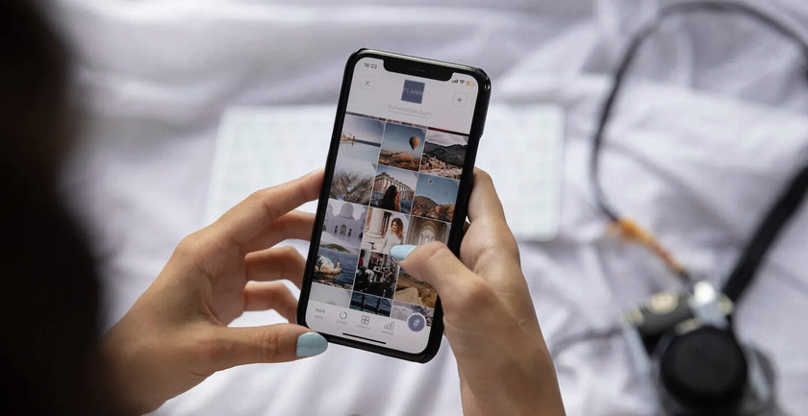



The Challenge in Advertising Today
Audience attention spans are shrinking
Traditional ads are losing engagement power
Brands struggling for innovative ideas

Slide 3
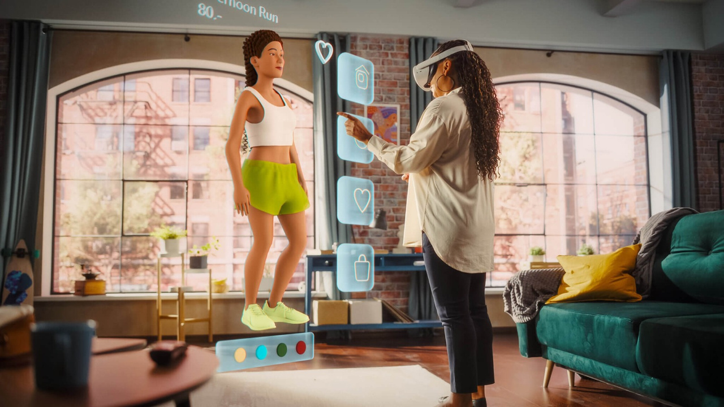


Solutions Overview
Augmented Reality
Immersive experiences that captivate audiences
CGI/3DaaS
Customized, interactive, and shareable campaigns
Metaverse
An immersive digital realm for engaging, interactive exploration, connection, and creation

Slide 4

Market Opportunity
Why Now?
$
Global AR ad market projected to reach $30B by 2030
+
70% of consumers are more likely to engage with interactive ads
#
Brands leveraging AR see 50% higher engagement rates compared to static ads

Slide 5
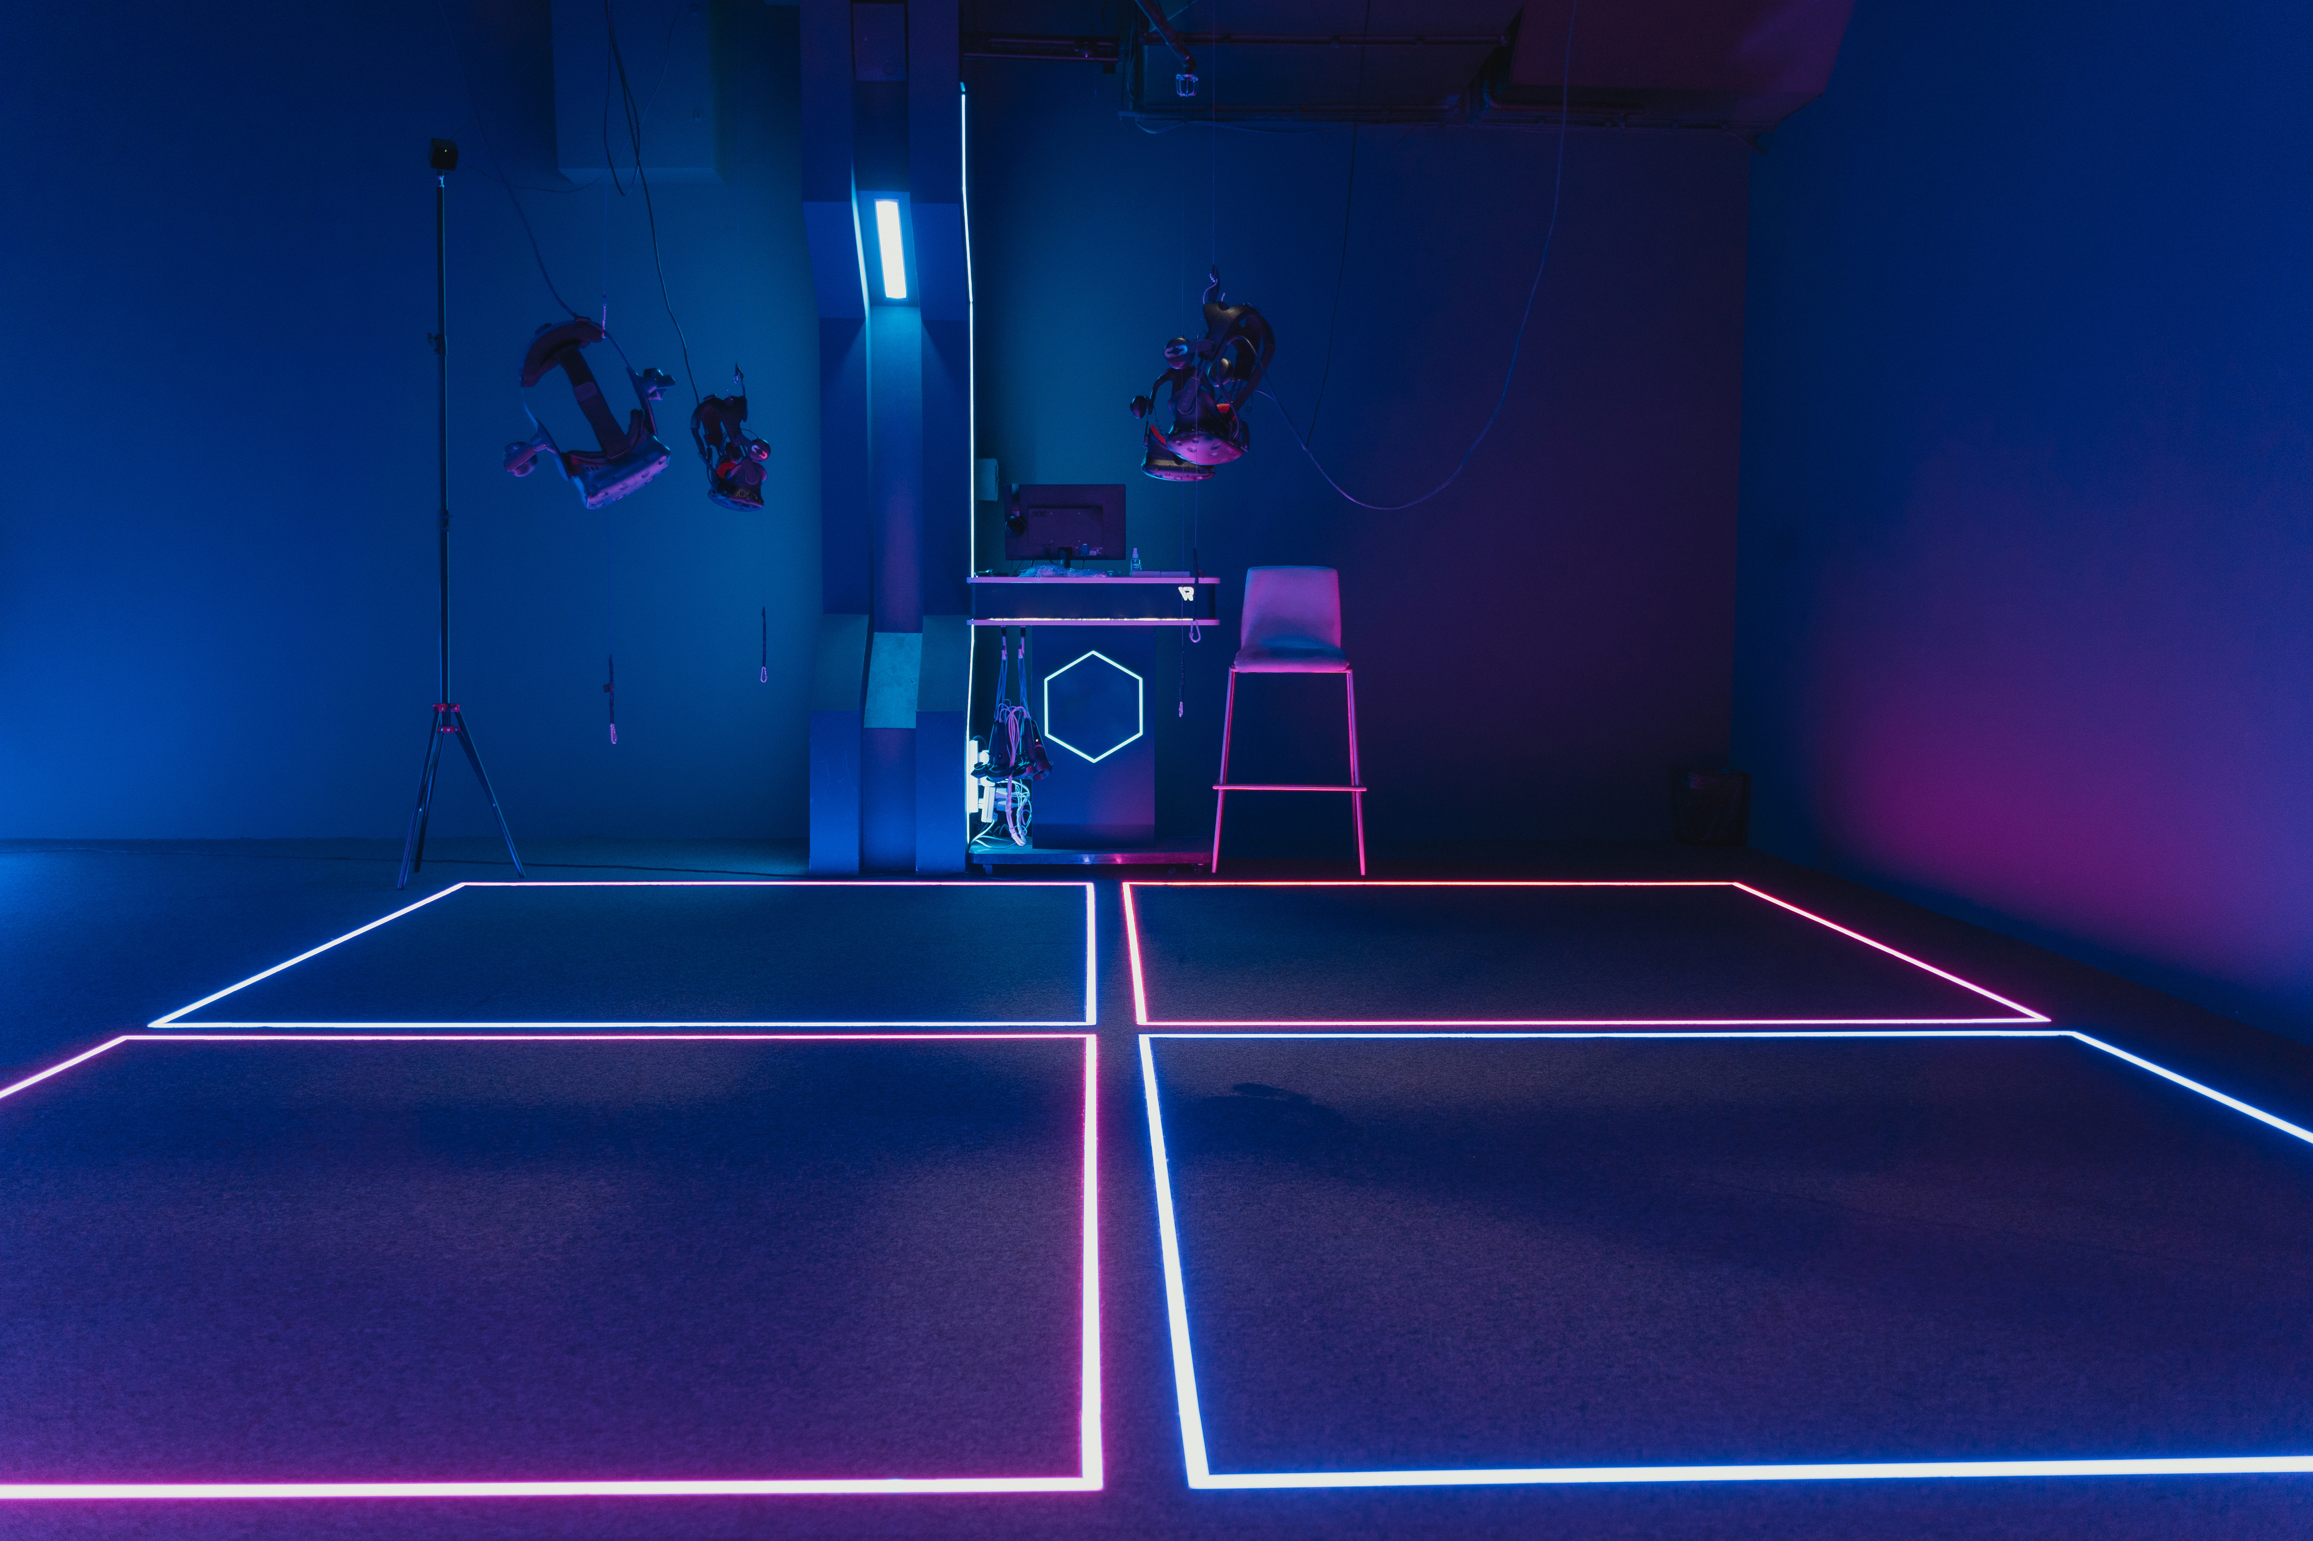

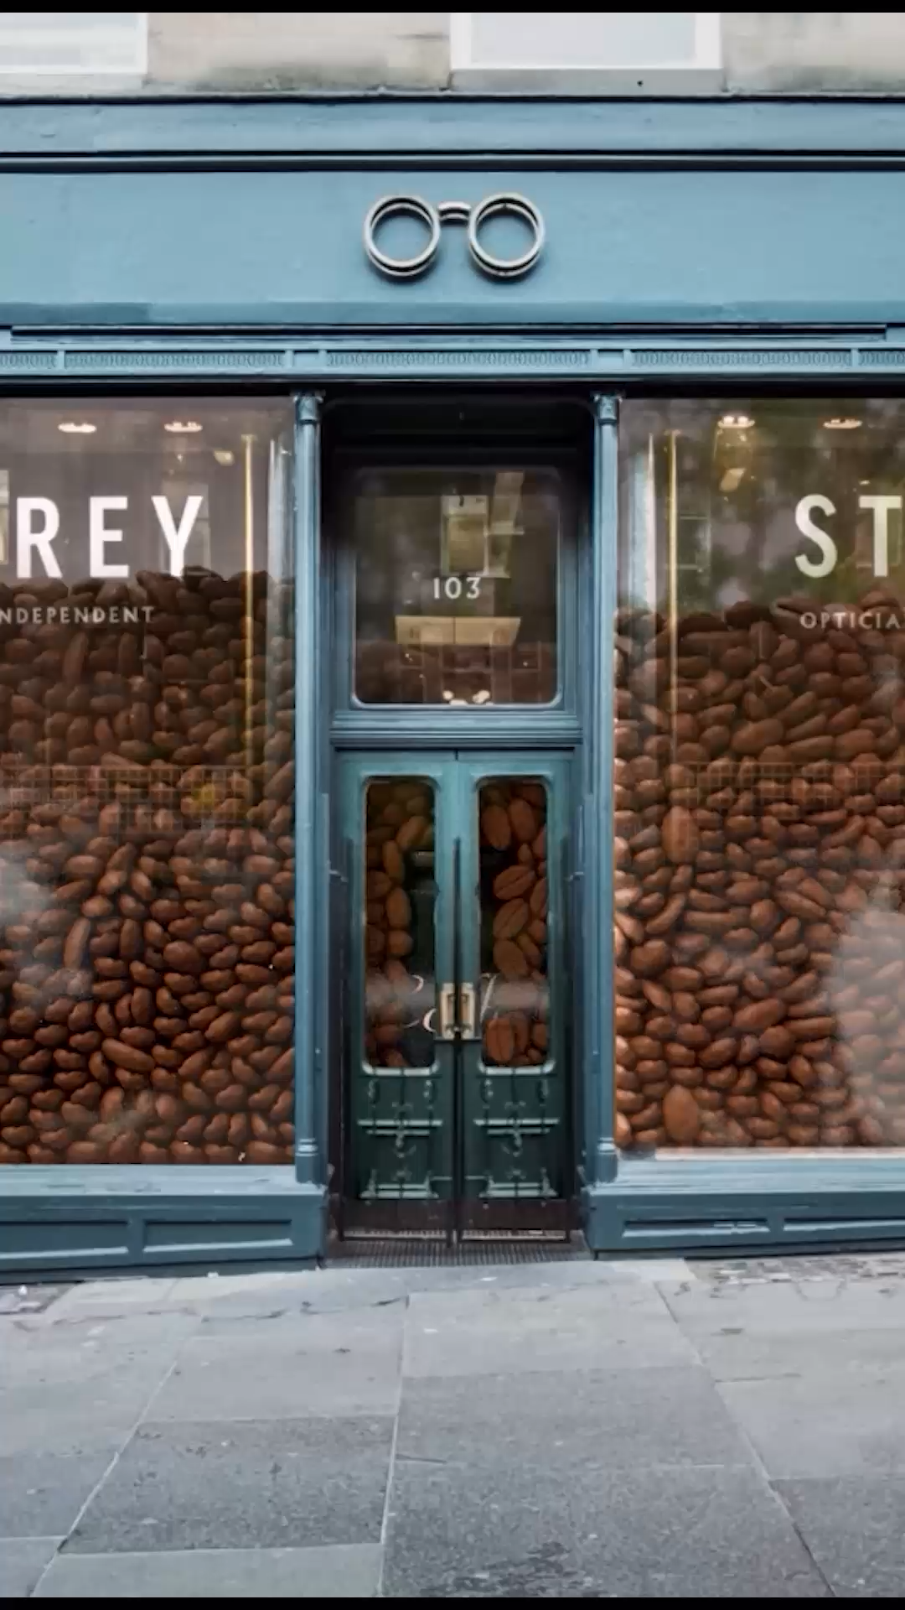
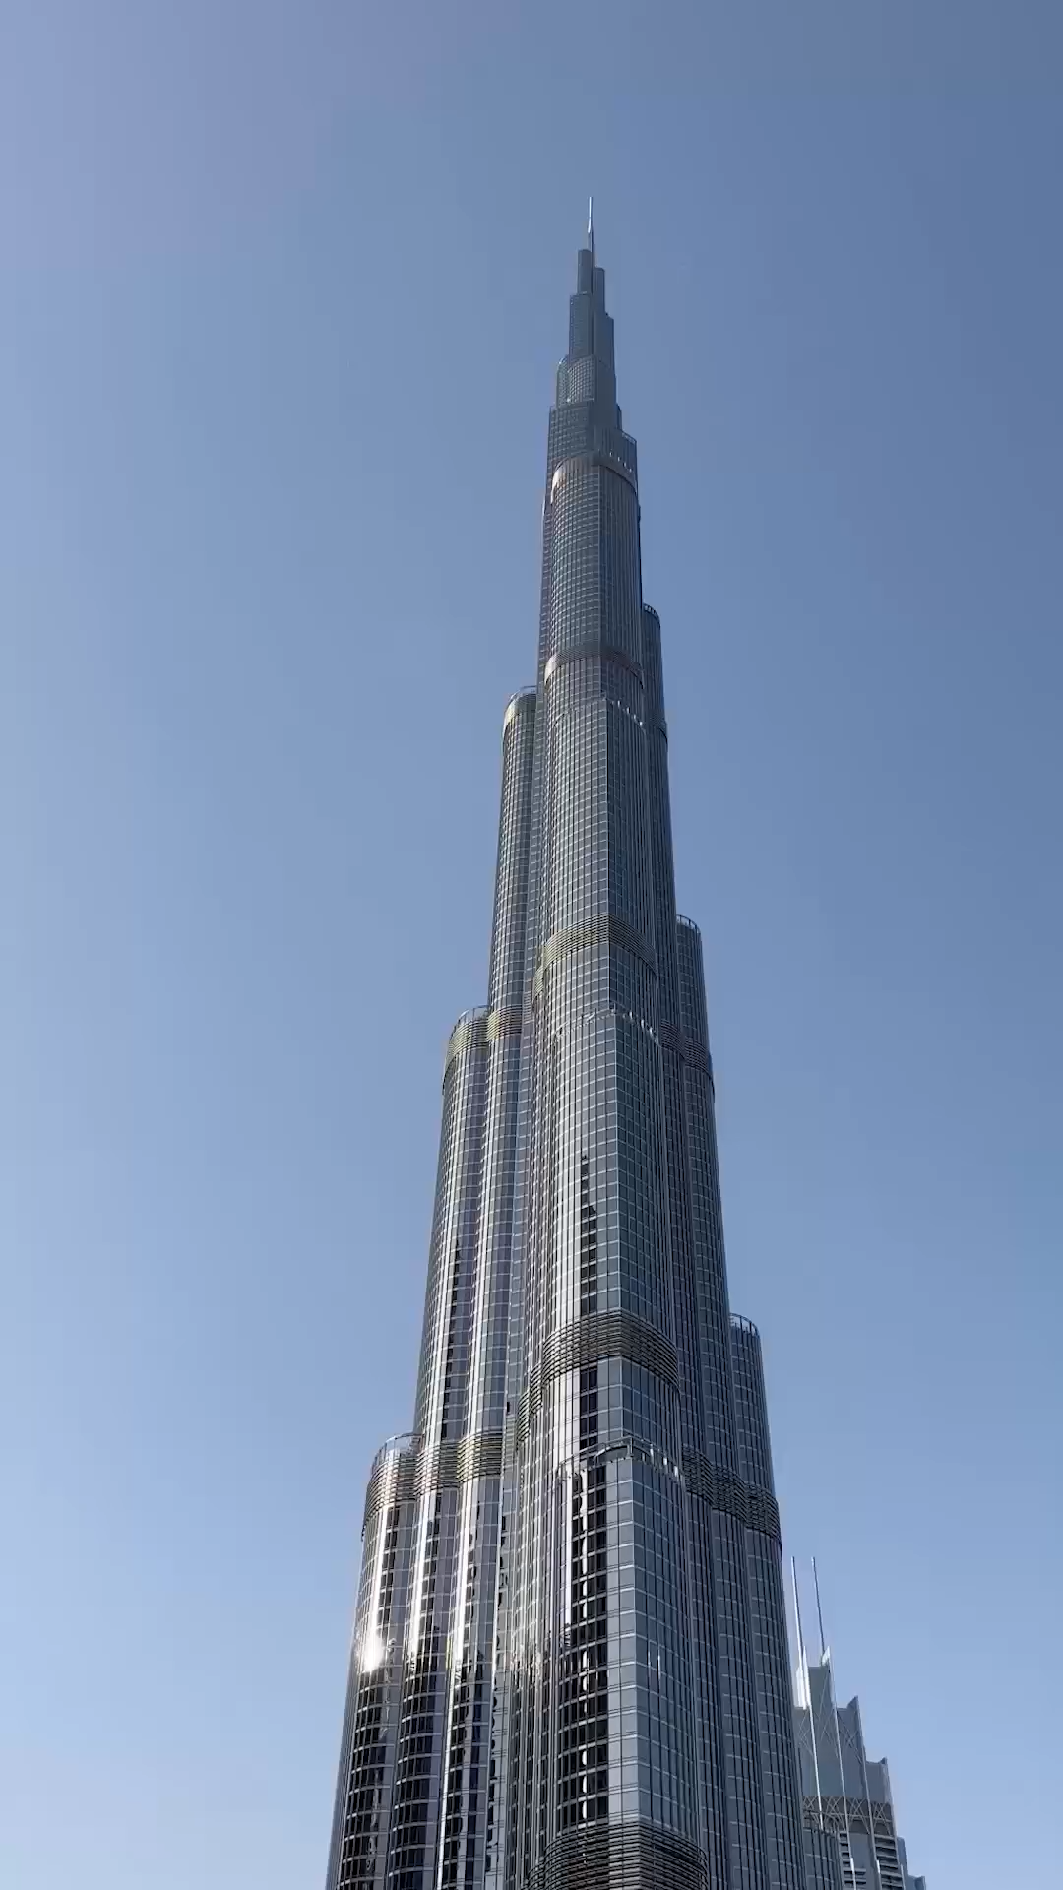
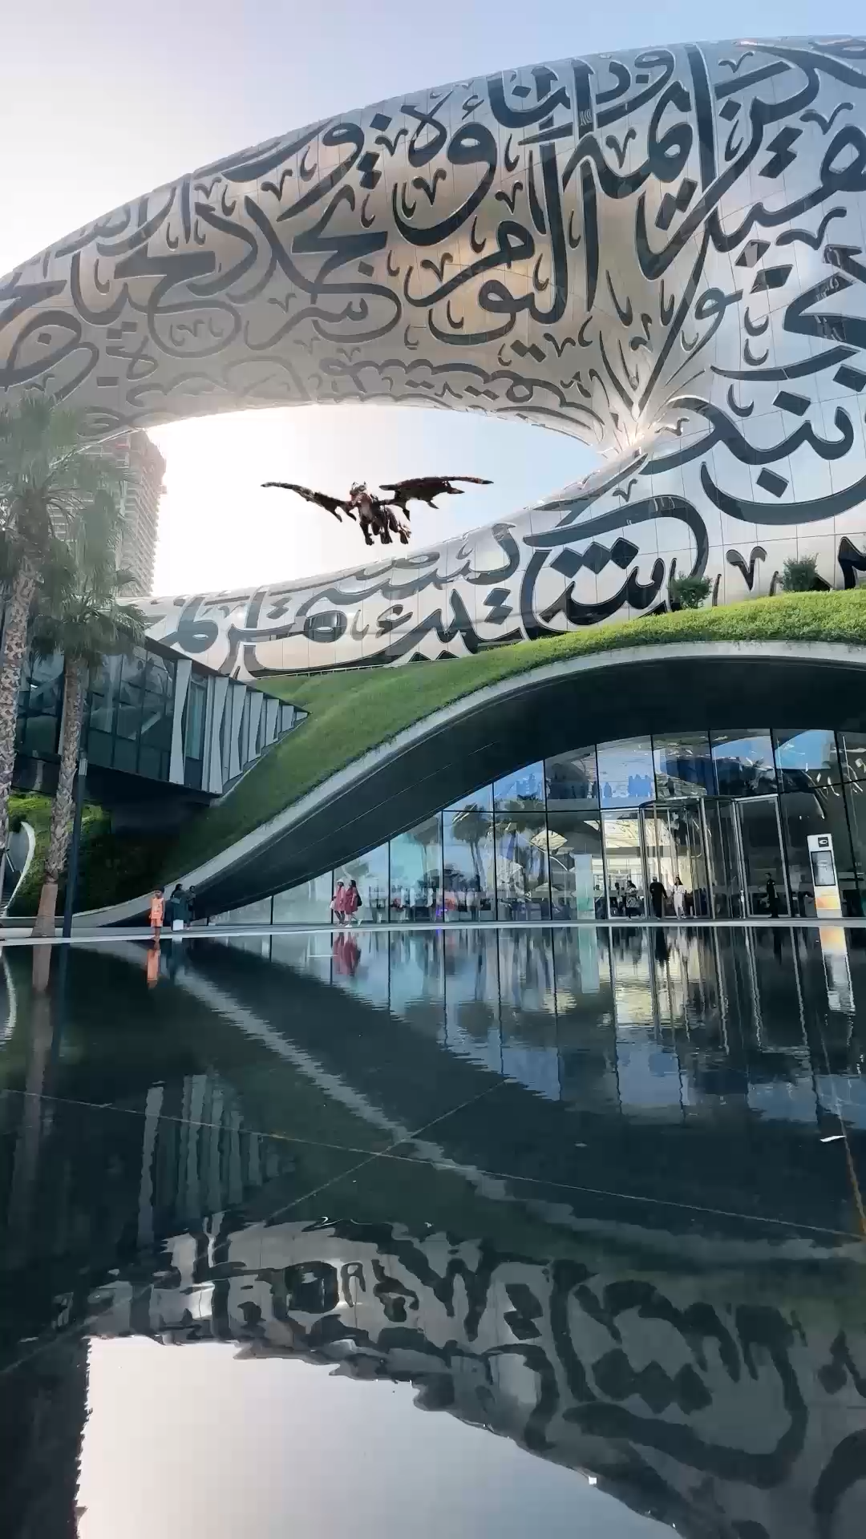
CGI Ads Examples
CGI/3DaaS

Slide 6
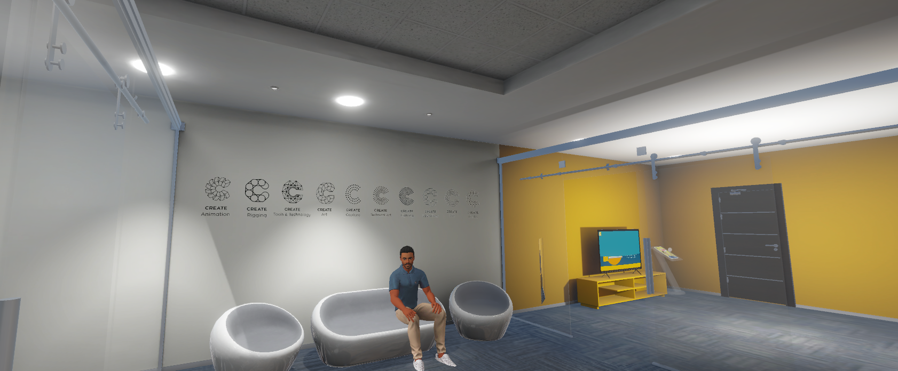
Metaverse Development
Metaverse
Link

Slide 7
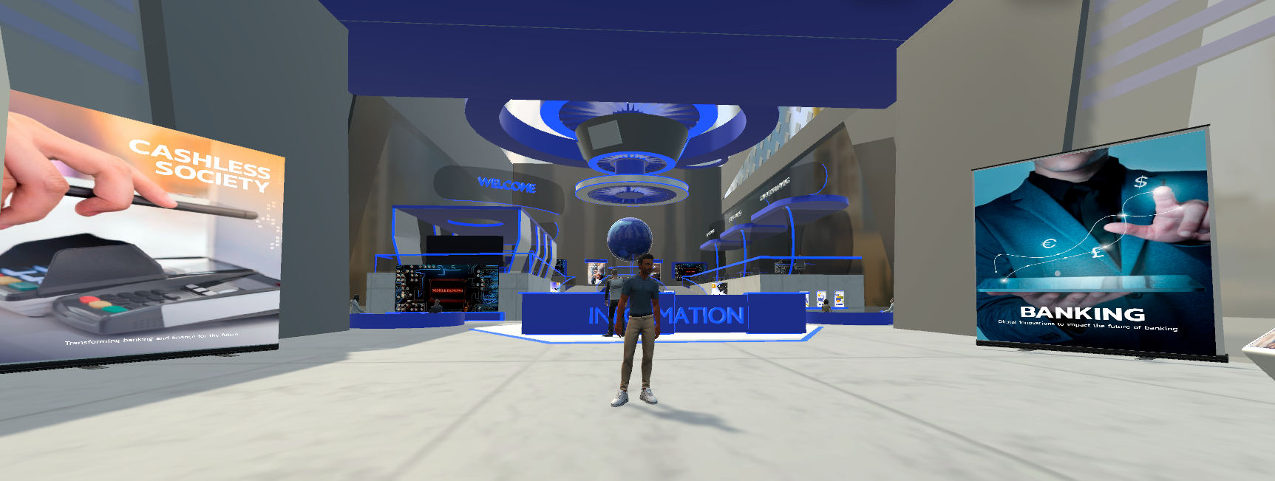
Metaverse Development
Metaverse
Link

Slide 8








Who We Serve
RETAIL
Entertainment
Automotive
Real Estate
Finance
Healthcare
Education
Manufacturing

Slide 9
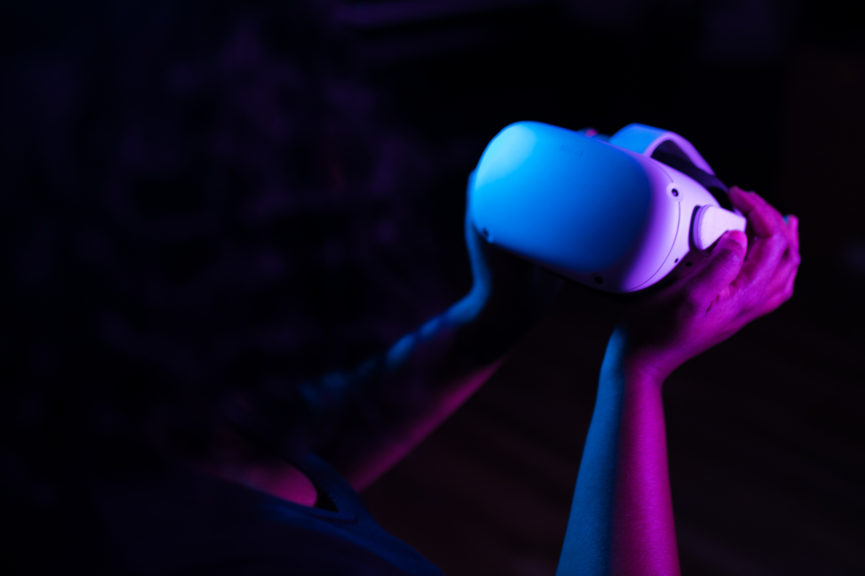



Our Vision for Growth
Build brand awareness and acquire marquee clients
Expand into new markets and industries
Launch proprietary AR platform for self-serve advertising

Slide 10
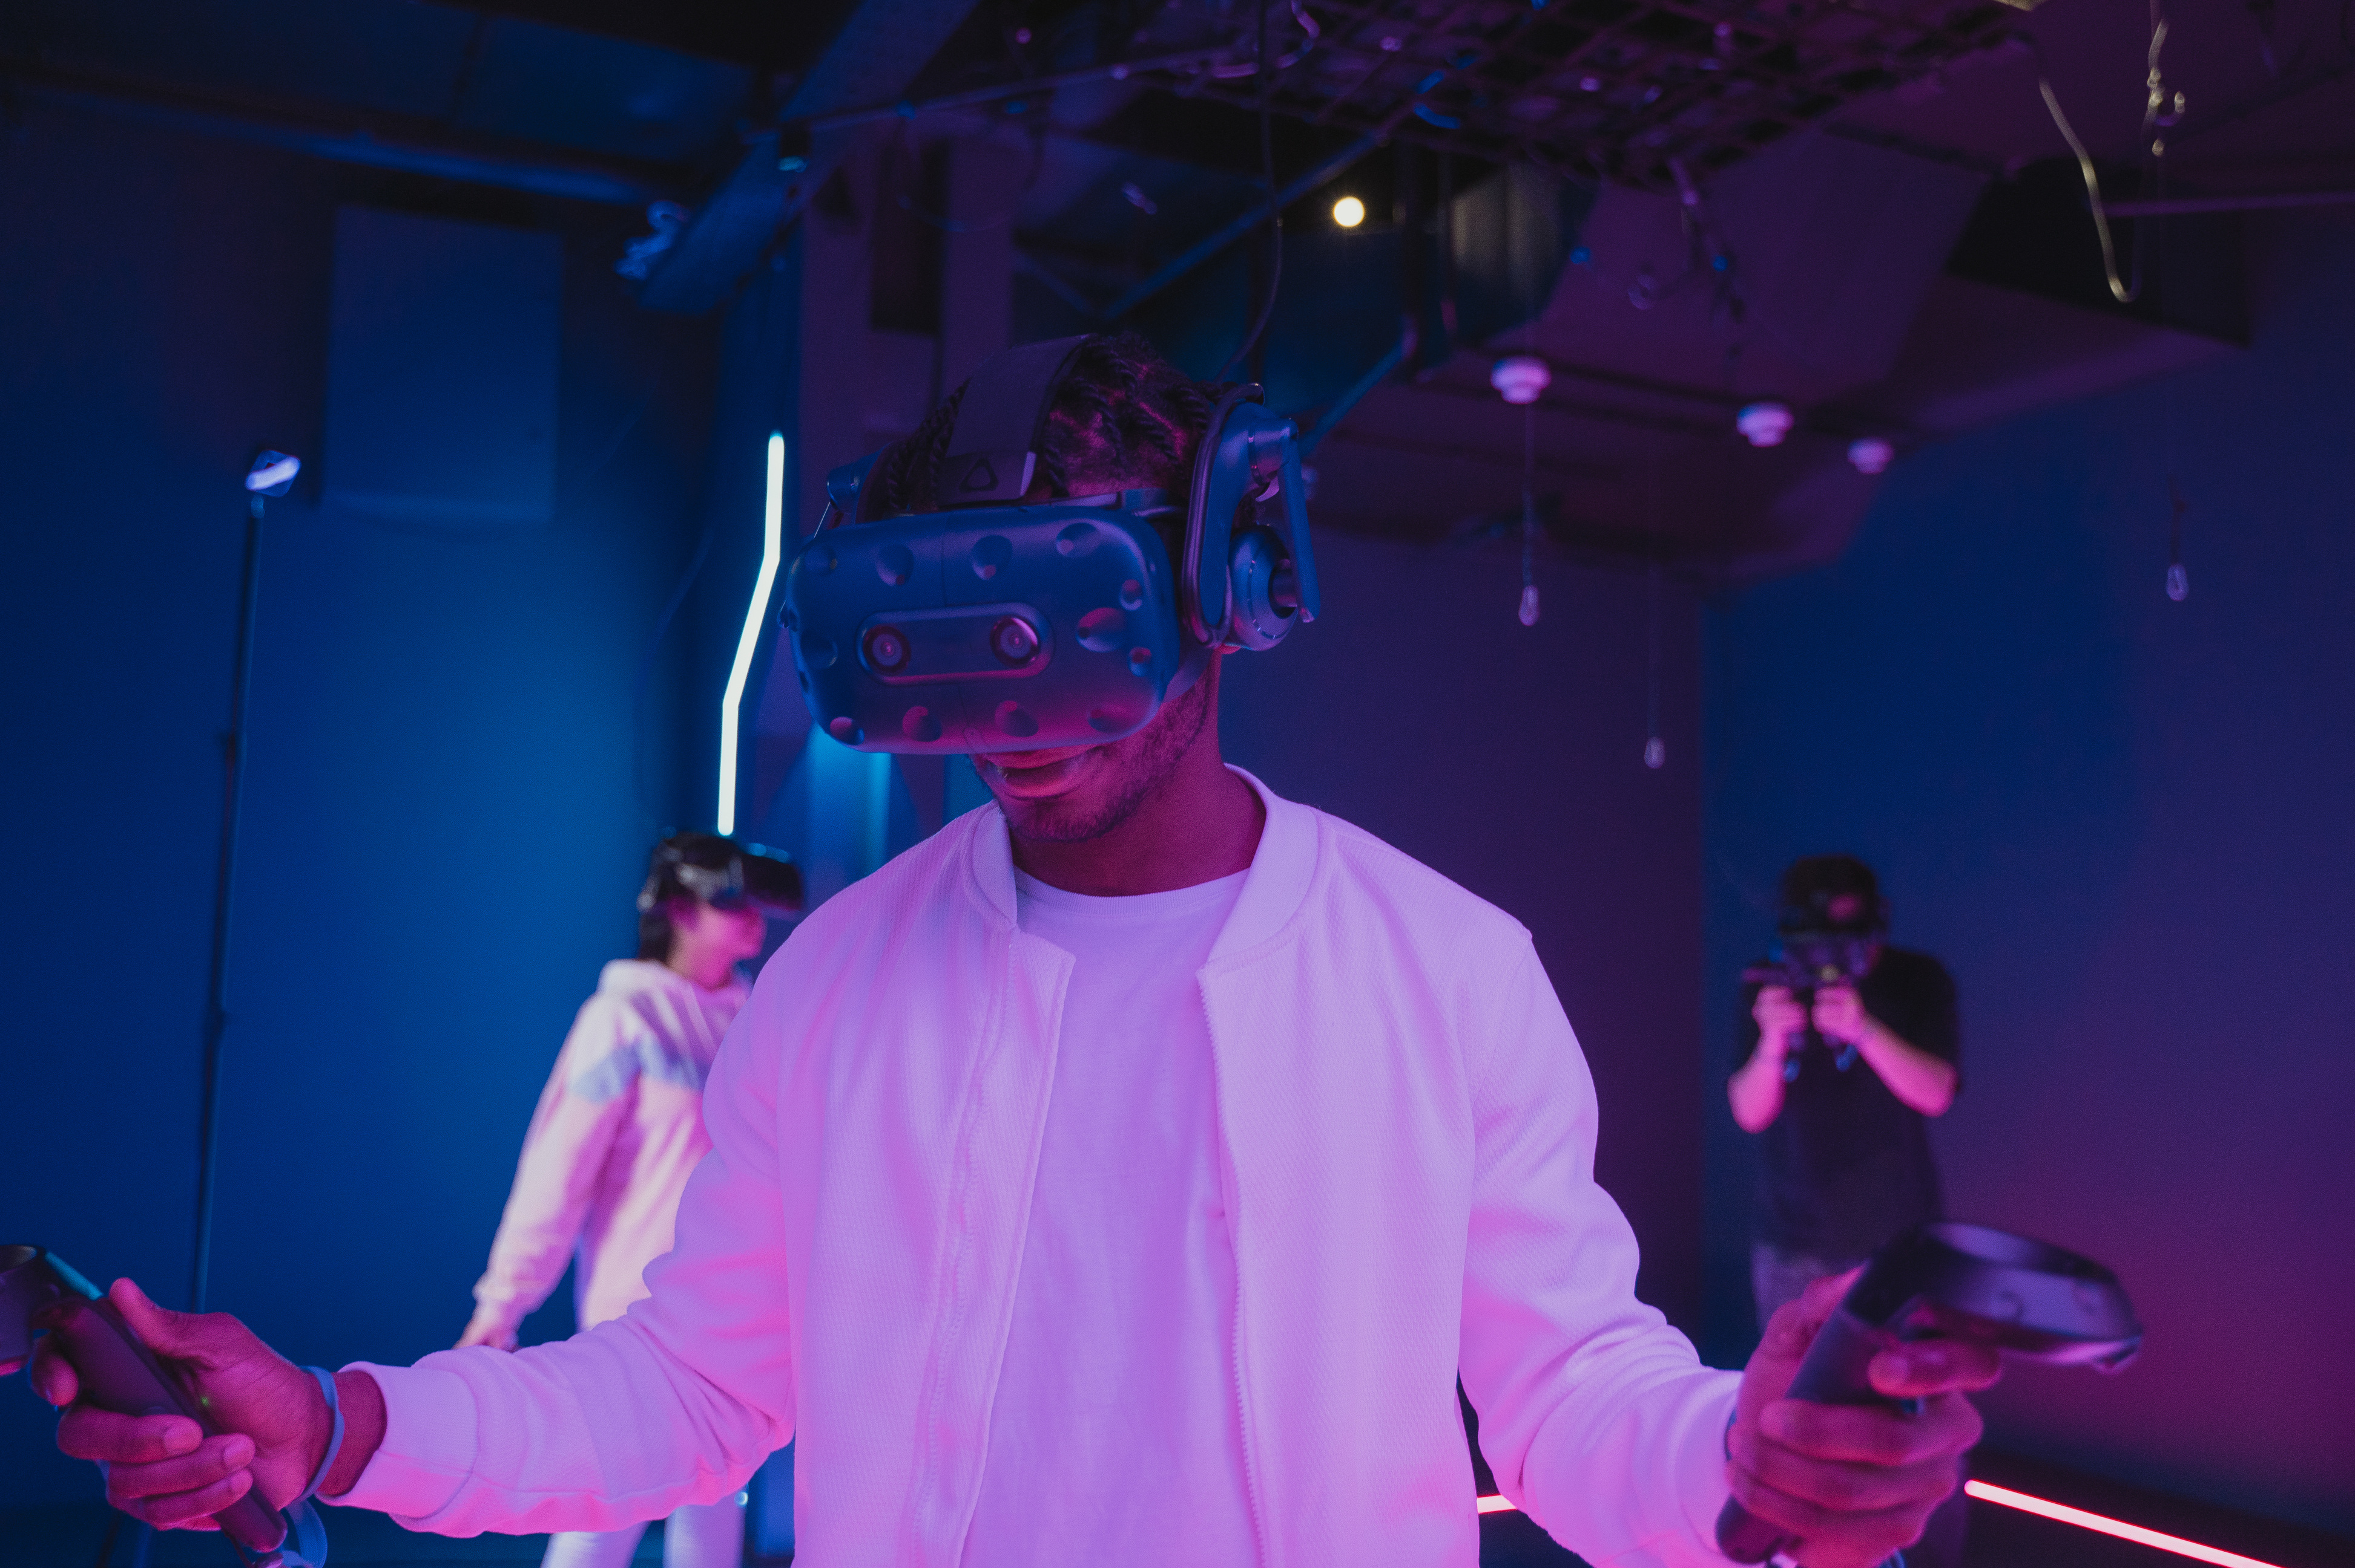




Let’s Create the Future of Advertising
www.layerxuae.com
info@layerxuae.com
Get in Touch
+971 585 868 494
@layerX

